Slide 1
Home-based long term care for adults and children with disabilities and older persons
Jolanta Reingarde| European Institute for Gender Equality
Zagreb, 2020

Slide 2
Social context
The share of population above 65 years in the EU is expected to increase from 19 % in 2016 to 29 % by 2080
The number of people with disabilities, including children, in need of long-term care (LTC) is on rise
Due to longer life expectancy, more women than men are in need of LTC services
An absolute majority of professional employees in the care sector are women
Women are also more likely to provide informal care to their family members
Care responsibilities are keeping 7.7 million women (aged 20-64) compared to 450K men out of the labour market in the EU
Notes:
The EU is currently experiencing unprecedented demographic changes. The share of population above 65 years in the EU is expected to increase from 19 % in 2016 to 29 % by 2080 and the percentage of people above 80 years will more than double to 13 % in that time. Given this context, the EU will face a major challenge in meeting long-term care needs in a financially sustainable way, ensuring that care is affordable without endangering the quality of services or the lives of care providers and the cared-for (Commission, 2017a).
Challenges related to LTC are highly gendered. Due to longer life expectancy, more women than men are in need of LTC services, therefore, they are more affected by the availability and quality of services. In the EU, an absolute majority of professional employees in the care sector are women. Women are also more likely to provide informal care to their family members when formal services do not suffice. Informal care is one of the main reasons behind a lower employment rate and higher inactivity of women in the labour market.
The European Pillar of Social Rights endorses everyone’s right to accessible, good-quality and affordable LTC services and, in particular, home care and community-based services. Although deinstitutionalisation and prioritization of formal home-based LTC is high on the political agenda, homecare services remain underdeveloped and difficult to access in many of the EU Member States, especially for certain groups of the population (people with low income, poorly educated people, migrants and ethnic minority women (Commission, 2009)). As a result, households are forced to provide care themselves or, in some Member States, to outsource care to domestic workers, who are often recruited with irregular contracts, work in precarious conditions and have limited social rights.

Slide 3
EU objectives for long-term care services
Universal access: access to services should be affordable for all citizens and not related to the income or wealth situation
High quality: focusing on more comprehensive quality assurance involving issues such as patients’ rights
Long-term sustainability: where the likely increase in LTC demand could be mitigated by preventive approaches and technological developments
Notes:
The European Pillar of Social Rights endorses everyone’s right to accessible, good-quality and affordable LTC services and, in particular, home care and community-based services. Although deinstitutionalisation and prioritization of formal home-based LTC is high on the political agenda, homecare services remain underdeveloped and difficult to access in many of the EU Member States, especially for certain groups of the population (people with low income, poorly educated people, migrants and ethnic minority women (Commission, 2009)). As a result, households are forced to provide care themselves (overall, women represent 62 % of all people providing informal LTC to older people or people with disabilities in the EU, especially women of pre-retirement age (50-64) (EIGE, 2019)) or, in some Member States, to outsource care to domestic workers, who are often recruited with irregular contracts, work in precarious conditions and have limited social rights.
In 2011, the Commission launched the European Innovation Partnership in Active and Healthy Ageing, which promotes greater autonomy and participation in paid employment of older persons as a way to decrease demand for LTC, but also to foster innovation and digital transformation in the field of active and healthy aging. For example, this initiative highlights the potential of digitalisation of health and care, although in a gender-neutral way, in helping informal carers to reconcile employment with caring for their dependent relatives. To tap into the potentially transformative effect on the division of informal care, digitalisation and smart home technologies should be more broadly investigated from a gender perspective (Wilson, Hargreaves, & Hauxwell-Baldwin, 2015).

Slide 4
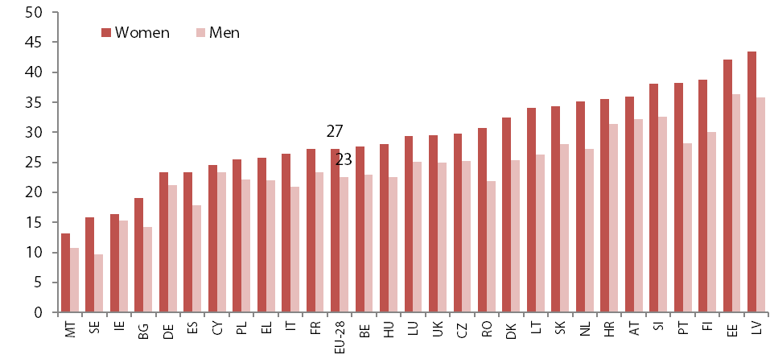
One in four people in the EU has a long-term disability
Source: EU-SILC, Eurostat, 2018
Notes:
Long-term care (LTC) is ‘a range of services and assistance for people who, as a result of mental and/or physical frailty and/or disability over an extended period of time, depend on help with daily living activities and/or [are] in need of some permanent care’ (Commission, 2014). LTC services can be formally performed by paid professionals in institutions (e.g. nursing home or residential care homes) or at home, or informally by family members, relatives, friends or others. The majority of countries heavily rely on informal care.
To improve quality of life and the efficiency of social care systems, the EU is moving towards the deinstitutionalisation of long-term care and supporting instead independent living at home through formal home-based or community based care. Formal home-based care is usually provided by licenced providers (employees or self-employed) in the home of the care dependent person (nurses, personal carers, including domestic workers). Formal home-based LTC is regarded to be a more cost-effective solution providing better care outcomes for the recipients compared to institutionalised care and, most importantly, reflecting people’s preference for home-based care.
The underlying assumption in this study is that people who have some kind of disabilities are (potentially) in need for help and for long-term care. Disability is a complex, evolving and multi-dimensional concept which can be defined and measured in various ways. The following sections highlight the segments of the EU population who ‘experience limitations in their daily activities due to health problems’, as is measured by EU-SILC, the main survey providing information on the home-based long-term care.
In the EU, one in four adults reports being limited or very limited in their daily activities as a result of a health problem. Large country differences: from 12% of the population in Malta to the highest burden of disability is observed in Latvia with 40% of adults reporting limitations. As shown in the Figure, in every EU country, women are more likely than men to experience limitations in daily activities due to health problems (27% of women compared to 23% of men). At the national level, the largest gender differences are seen in Portugal (10 p.p.), Romania (9 p.p.) and Finland (9 p.p,). In the majority of EU countries the share of people with long-standing limitations has increased since 2008. Such trends reflect the fact that gains made in life expectancy in the past decades have been accompanied by an increase in the occurrence of chronic diseases that can limit the ability to handle some daily activities and lead to an increasing need for LTC.

Slide 5
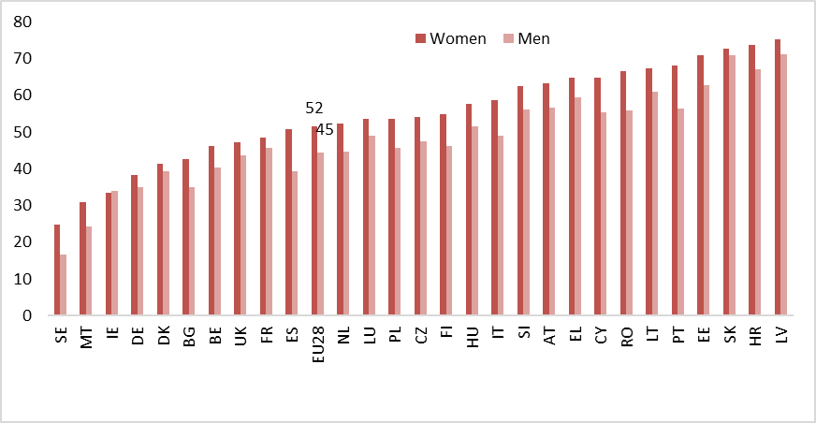
Gender differences in limitations in everyday activities increase with age
Women and men aged 65 and over limited in their usual activities, 2018
Source: EU-SILC, Eurostat, 2018

Slide 6
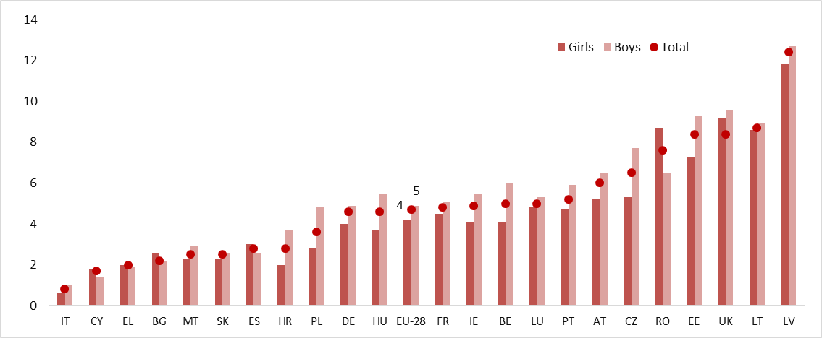
About 5% of EU families with children have a child or children with disabilities
Source: EIGE calculations based on EU-SILC, Eurostat, 2017

Slide 7
Only a quarter of households with people with disabilities receive formal LTC
Source: EIGE calculations based on EU-SILC ad hoc module, Eurostat, 2016

Slide 8
Every third family in the EU lives without adequate professional home care services
Unmet household need for professional home-based care services, 2016
Source: EIGE calculations based on EU-SILC ad hoc module, Eurostat, 2016

Slide 9
Main reason for unmet need – inability to afford such services
Source: EIGE calculations based on EU-SILC ad hoc module, Eurostat, 2016

Slide 10
Although a demand for LTC is increasing, the sector is facing a major shortage of labour force
Social workers providing home-based services per 100 persons with disabilities, 2018
Source: EIGE calculations based on Eurostat data, 2018

Slide 11
During the last ten years the share of women in social work remained unchanged
Source: LFS, Eurostat, LFS, 2018

Slide 12
In many EU countries employment conditions in the formal care sector are low quality and precarious
High intensity of work (determined by high emotional demands, and high workload)
Adverse social environment (high risk of abuse, harassment, and under-appreciation)
Atypical working time (working at night and/or on weekends, frequent changes to working time arrangements)
Low income

Slide 13
Concluding remarks
Long-term care needs are on rise and affect women disproportionately
Nearly every tenth person enter adulthood with health limitations
Shortage of formal long-term care puts economic independence of women at risk
Informal carers need support and their contribution to economy needs to be recognized
Better remuneration and social protection required for long-term care providers to account for difficult working conditions
Ambitious and gender-specific policy goals are needed

Slide 14
Let’s talk
Connect with us!
eige.europa.eu
facebook.com/
eige.europa.eu
twitter.com/
eurogender
come in for a chat!
eige.europa.eu/
newsletter
eurogender.eige.
europa.eu
youtube.com/
user/eurogender
Gedimino pr. 16,
LT-01103 Vilnius,
Lithuania

